Slide 1
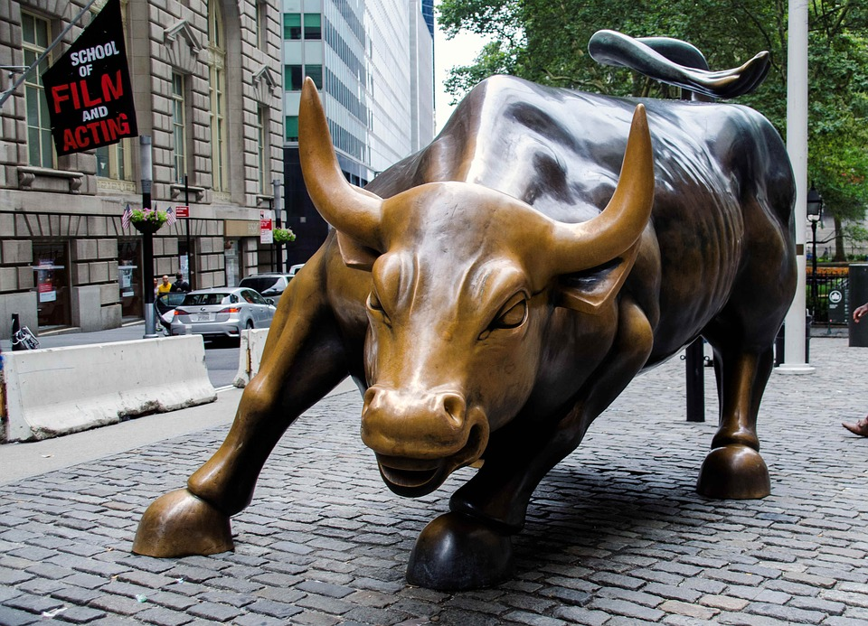
The Effect of Corporate Earnings Calls On the Stock Market
-An Analysis Using
Natural Language Processing
By: Ehi Eromosele

Slide 2

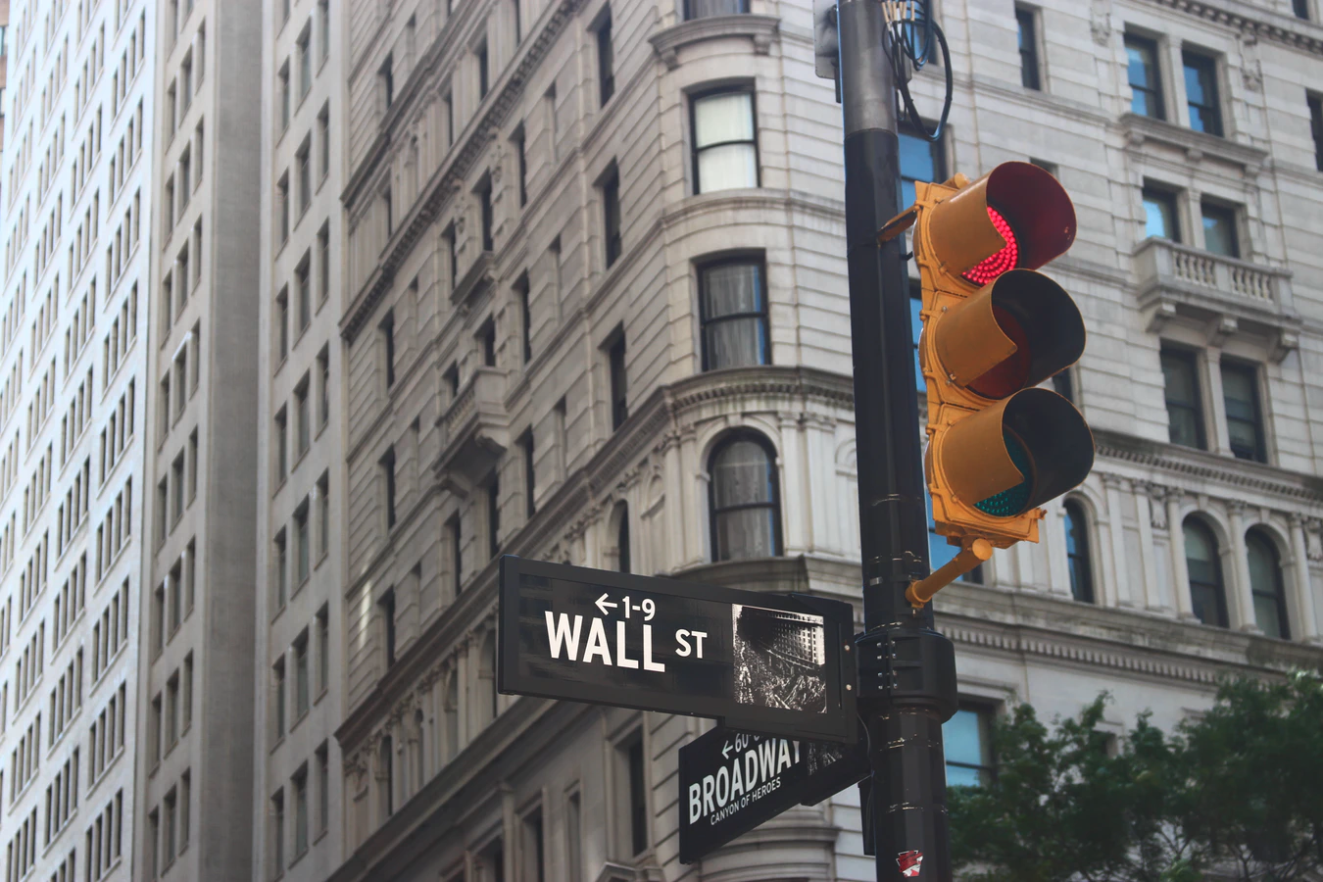
About myself
Ehi Eromosele - Data Scientist
Background: Mathematics & Statistics
Interested in applying data science to solve problems in the finance industry.
Inspired from movie ‘Wall Street” and “Wolf of Wall Street”

Slide 3

ABOUT THE PROJECT
In the year 2020, the stock market has seen some high volatility due to COV-19. I applied sentiment analysis to a portfolio of stocks.
I have chosen to analyze earnings call transcripts. An earnings call is a conference call between the management of a public company (CEO, CFO, & etc.), analysts, investors.
An earnings call discusses the company's financial results during a given reporting period, such as a quarter or a fiscal year
Notes:
In the year 2020, the stock market has seen some high volatility due to COV-19. I applied sentiment analysis to a portfolio of stocks.
I have chosen to analyze earnings call transcripts. An earnings call is a conference call between the management of a public company (CEO, CFO, & etc.), analysts, investors.
An earnings call discusses the company's financial results during a given reporting period, such as a quarter or a fiscal year

Slide 4

OBJECTIVES
Find data for earning call transcripts going back five years.
Apply Natural Language Processing to each transcript.
Run regressions to determine the effect of keywords on prices.
Run algorithm to determine the sentiment of each conference call.
Predict future gains/losses.

Slide 5
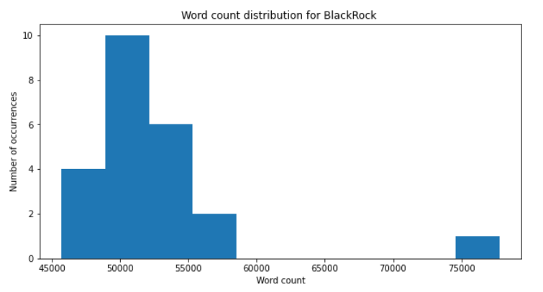
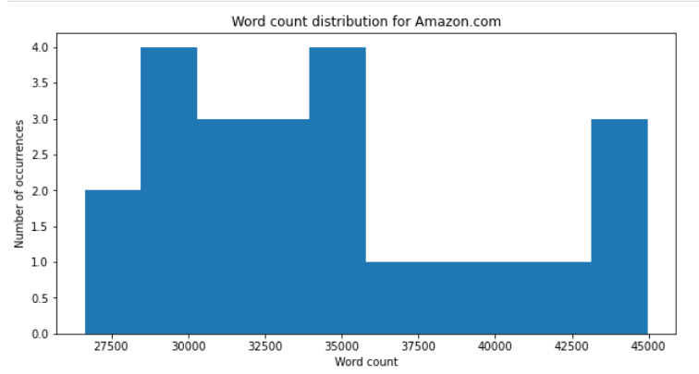
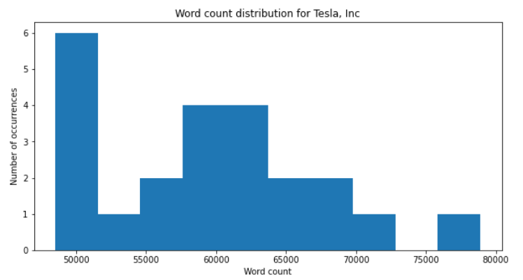
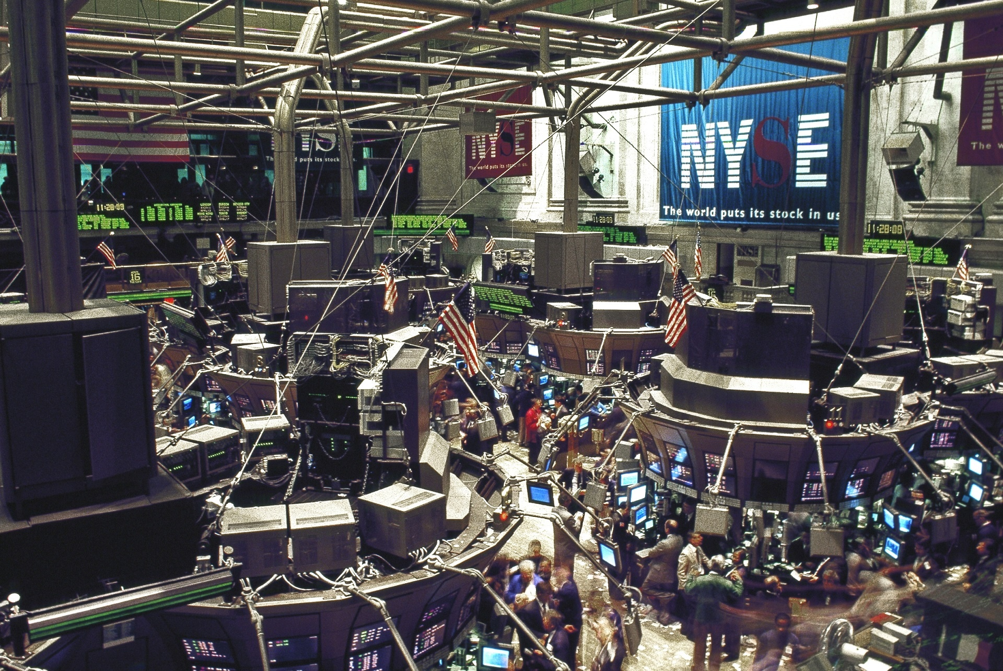
Transcript Data Visualization
Each earnings call has certain amount of words. This could be a important factor in determining sentiment.
Length of words on a call might be a measure of how much news there was on stock; therefore, it shows how much impact of a stock price.
In assumption, big news tend to have more need of a conversation in why something occurred.

Slide 6
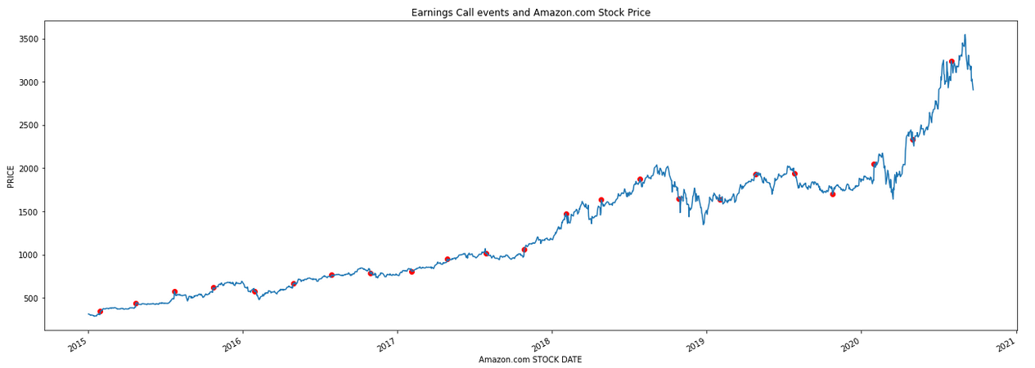

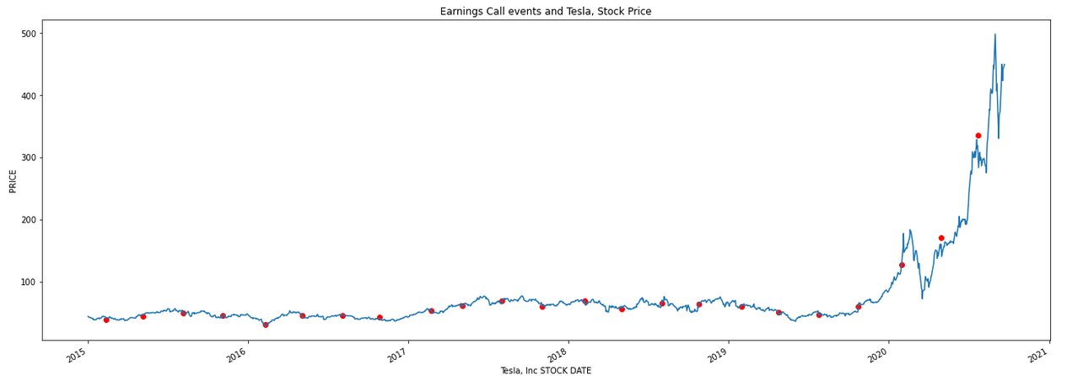

Earnings Call Event & Stock Price
For the past five years, earnings reports have been important indicators of stock price movement.
Amazon has had consistent growth due to aws services, prime, & one day shipping.
Tesla exploded with news of cyber truck, ev production, SpaceX.

Slide 7
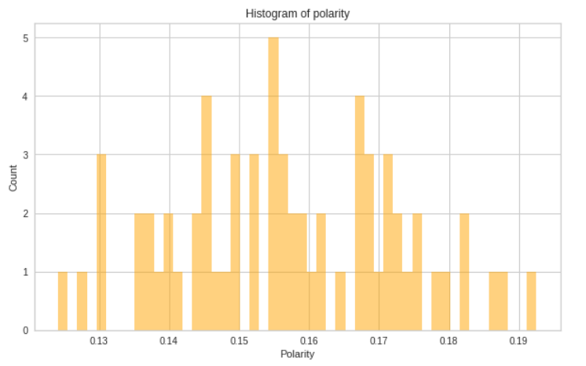
Sentiment
Analysis
Good
Neutral
Bad
Sentiment analysis is the interpretation and classification of emotions (positive, negative and neutral) within text data using text analysis techniques.
The results displayed how many emotions occured after each earnings call. Emotions are determined with polarity. Polarity takes into account the amount of positive or negative terms that appear in a given sentence.
BlackRock
BlackRock
BlackRock
23
0
0
Tesla
Tesla
Tesla
23
0
0
Amazon
Amazon
Amazon
23
0
0

Slide 8
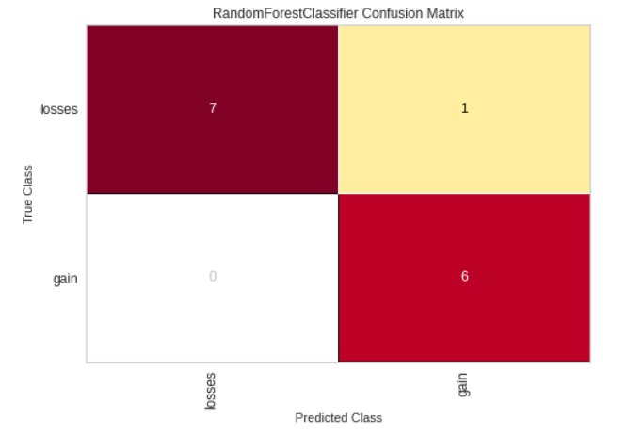
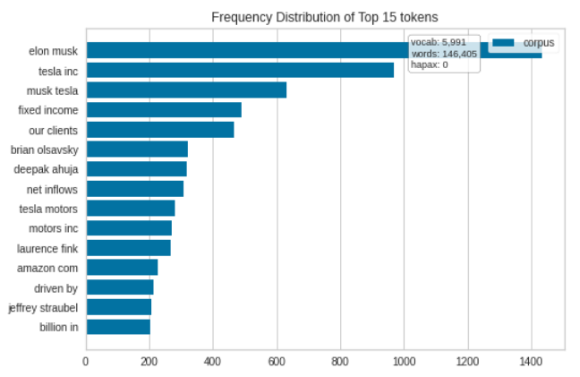
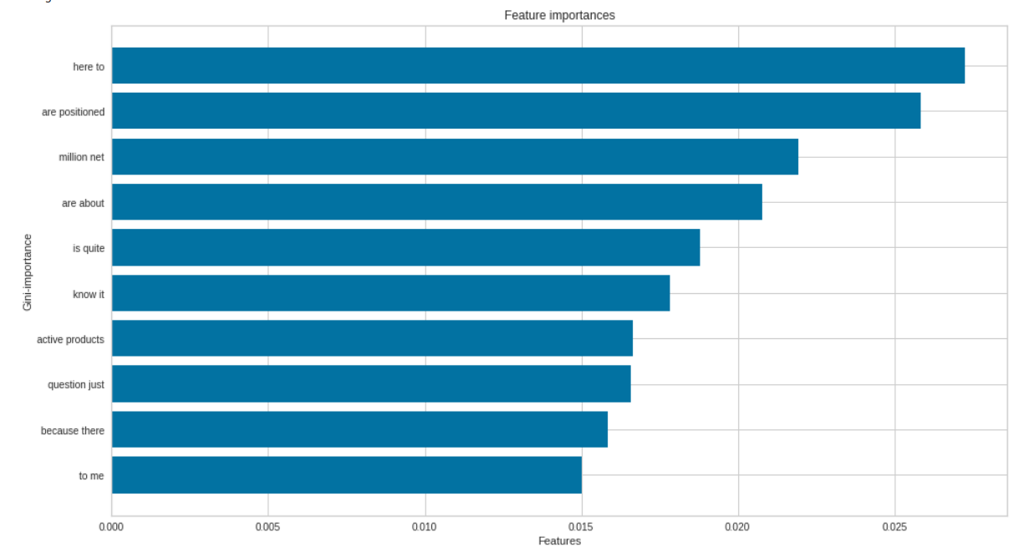
Random Forest
The Random Forest classifier model gave me the best results. Accuracy score was 0.42

Slide 9
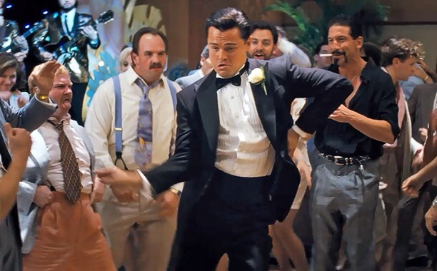
Next STEPS
Implement content analysis toward the text; this process will help determine the presence of certain words, themes, or concepts.
Attain more data for transcript/stock information going 10+ years.
Read more on financial machine learning books.

Slide 10
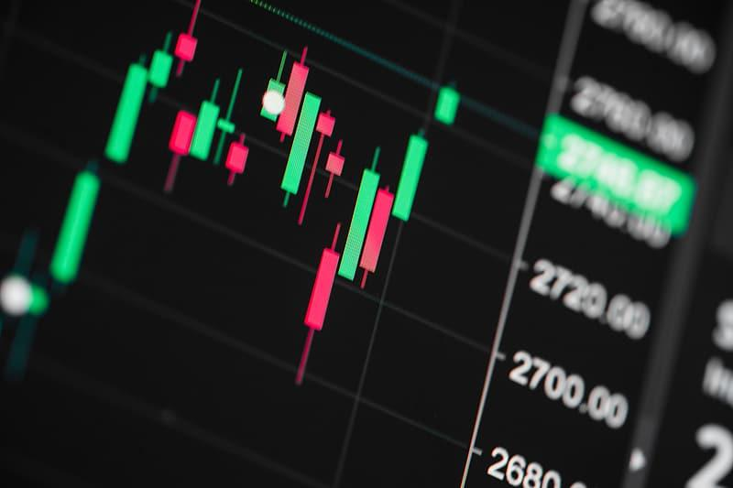
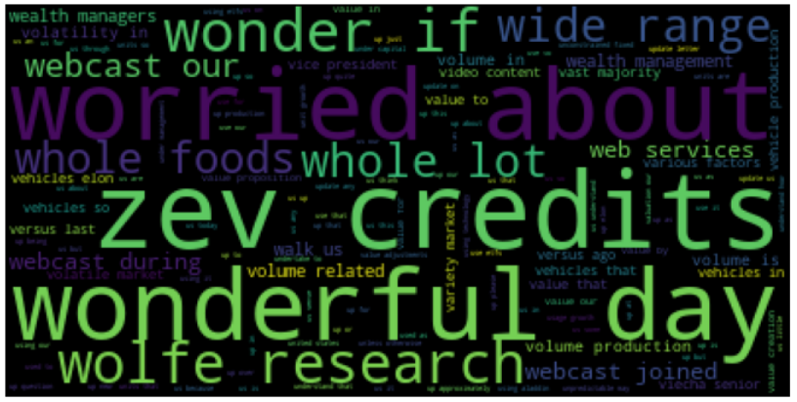
Conclusion:
The sentiment analysis showed similar polarity values. This might be due to financial terms/difficult words used in conversation. I need more data to confirm this.

Slide 11

THANKS FOR ATTENDING
Does anyone have any questions?
eromosele.ehi@gmail.com
+91 620 421 838

Slide 12

“If you want to be rich, never give up. People tend to give up. If you have persistence, you will come out ahead of most people. More importantly, you will learn. When you do something, you might fail. But that’s not because you’re a failure. It’s because you have not learnt enough. Do it differently each time. One day, you will do it right. Failure is your friend.”
—Jordan Belfort, The Wolf of Wall Street

Slide 13
PROJECT TIMELINE
Venus has a beautiful name, but it’s terribly hot
PHASE 1
Mercury is the smallest planet in our Solar System
PHASE 2
Despite being red, Mars is a cold place, not hot
PHASE 3
Jupiter is the biggest planet in our Solar System
PHASE 4

Slide 14
DATES
[ Date ] - Milestone 1
[ Date ] - Milestone 1
SAFEGUARDS
[ Date ] - Milestone 2
[ Date ] - Milestone 2
RISKS & ISSUES
STATUS REPORT
Risks: New competitors
Risks: New competitors
MITIGATIONS
Issue: Milestone 1
Issue: Milestone 1
TARGET
Market share - Up 2%=%
Market share - Up 2%=%
ACTIONS
Delivery Manager recruited
Delivery Manager recruited

